Slide 1

Welcome! MHR Incubator Gathering 2025

Slide 2

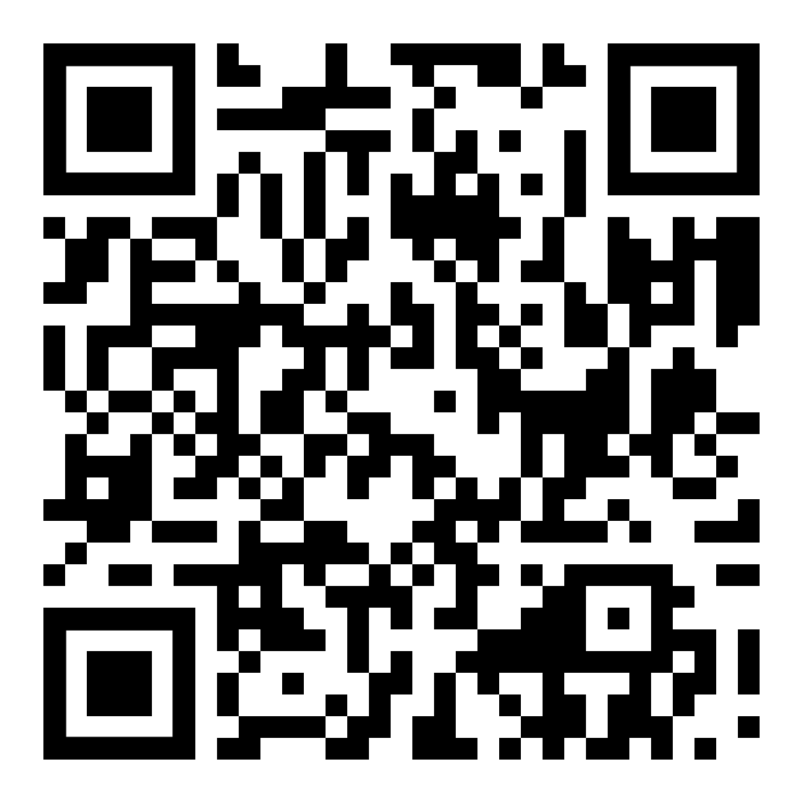
Networking Round 1
Introduce yourselves to each other
What are you working on at the moment?
In terms of your research interests – what are you most passionate about?
What theme connects you all?
Groups 1-11 in Hall; Groups 12 & 13 in G1; Group 14 in G3; and Group 15 in G4.

Slide 3
Networking Round 2
Introduce yourselves to each other
What are you working on at the moment?
What research questions most interest you?
Groups 1-11 in Hall; Groups 12 & 13 in G1; Group 14 in G3; and Group 15 in G4.

Slide 4
Skills workshops

Slide 5
Hosted conversations
Conversation 1: 1.20pm-1.50pm
Conversation 2: 1.55pm-2.25pm
2.30pm - back to the main hall!

Slide 6


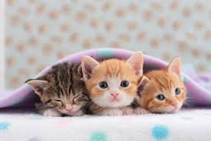
What will you take away from the Gathering?
e.g.: feeling, action, connection
Please choose a postcard that resonates with you

Slide 7

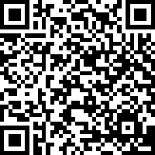
Very short evaluation form!
Thank you ☺

Slide 8


Stay in touch ☺
www.mentalhealthresearch.org.uk
@MHRIncubator.Bsky.social
Notes:
Finally we’re on X – please follow and share there!

