Slide 1

Paradigm shifts in evidence synthesis: From static unidimensional evidence synthesis ecosystems to a dynamic multidimensional ecosystem of evidence
Wagner Silva-Ribeiro
Care Policy and Evaluation Centre
London School of Economics and Political Science
W.Silva-Ribeiro@lse.ac.uk
Mental Health Research Incubator Gathering – 4 November 2025

Slide 2

General Research Interests
Methods Expertise
Mental health
Health systems research
Implementation Science
Global mental health
Epidemiology
Quantitative research methods
Systematic review
Meta-analysis

Slide 3
Westfall et al. JAMA. 2007;297(4):403-406 (doi:10.1001/jama.297.4.403)

Slide 4

Founder: Iain Chalmers et al.
UK Cochrane Centre, Oxford (1992)
Cochrane Collaboration (1993)
77 people, 9 countries in 1993
Over 21,000, 120 countries in 2015
Over 6,300 published reviews
Online library
*Main focus: reviews of interventions

Slide 5


Slide 6
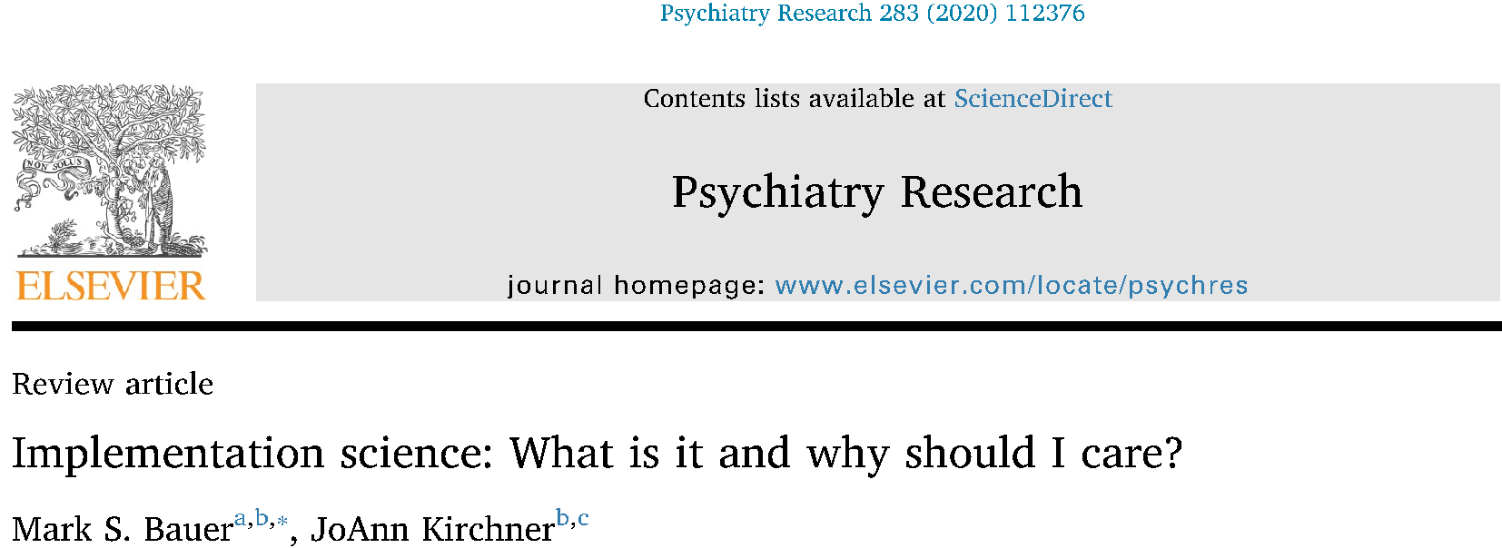
From effectiveness to adoption: 17-20 years
Less than 50% of innovation make it into clinical practice
80% of medical research investment do not make public impact

Slide 7
Shortfalls of traditional evidence synthesis methods
Restrict in scope
Time- and resource-consuming
Duplication of efforts
Running out of date
Suboptimal quality

Slide 9
Shortfalls of traditional evidence synthesis methods
Restrict in scope
Time- and resource-consuming
Duplication of efforts
Running out of date
Suboptimal quality

Slide 10
Obsolescence
Medline search: RCTs on psychotherapy for child and adolescent depression
Year | Number of new references
2021 | 157
2022 | 133
2023 | 152
2024 | 146
2025 | 147
Proposed solutions:
New statistical approaches
Living systematic reviews

Slide 11
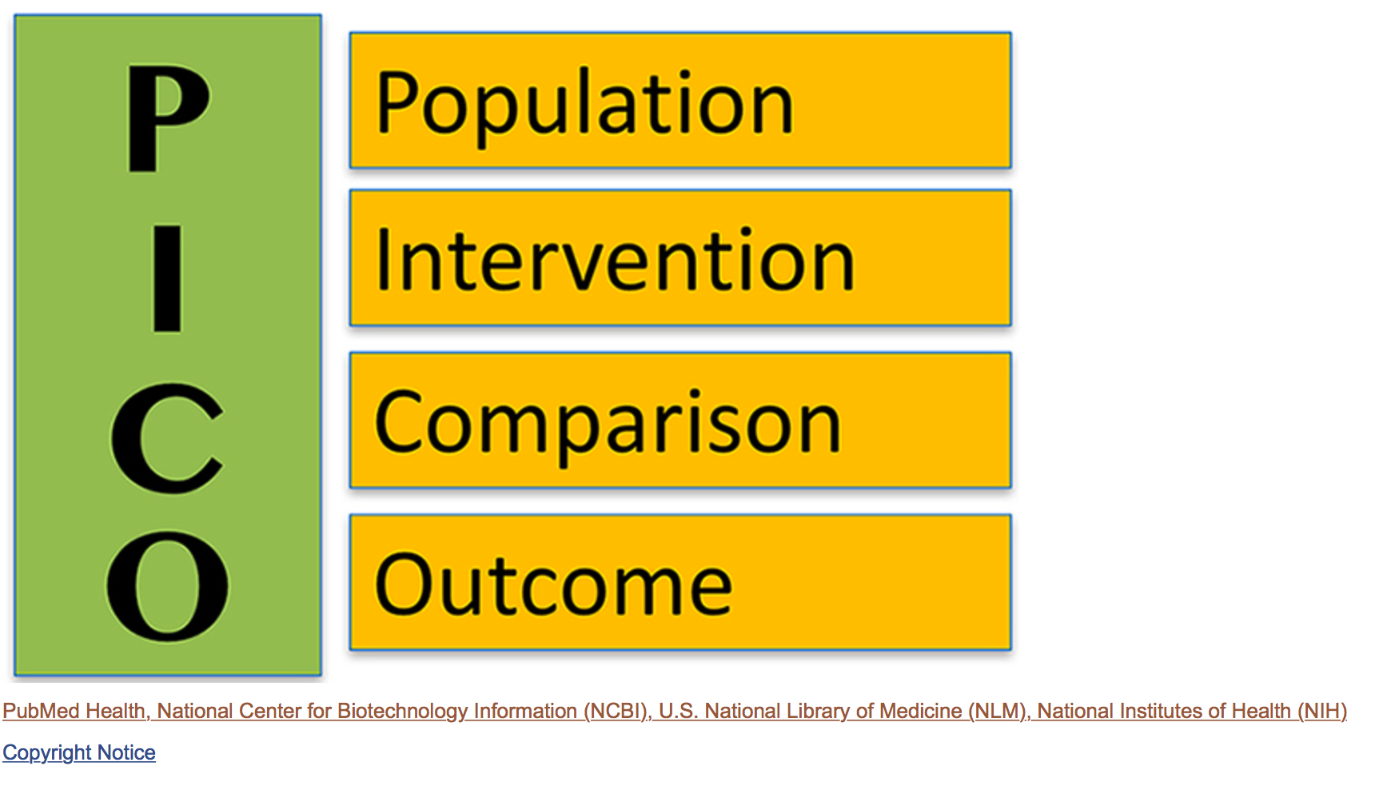
Scope narrowness
Proposed solutions:
MARD
Ecosystem/universe of evidence
Source: https://www.ncbi.nlm.nih.gov/pubmedhealth/PMHT0029906/

Slide 12
Scientific/clinical problem
PECO
Population
Exposure
PICO
Population
Comparison
Intervention
Outcome
Comparison
Outcome
PICO
Population
Intervention
Comparison
Outcome

Slide 13
A living systematic review approach to identify the most effective psychotherapies and psychotherapy components to treat child and adolescent anxiety and depression: review protocol
Ribeiro et al., 2025
Intervention effectiveness | Traditional systematic review and meta-analysis
Comparative effectiveness | Network meta-analyses
Intervention component comparative effectiveness | Component network meta-analyses; meta-regression analyses
Predictors of effectiveness | Meta-regression and subgroup analyses
Economic aspects | Additional searches; secondary analyses of review data
Main output:
Child and adolescent emotional problems
PECO
Population
PICO
Population
Exposure
Intervention
Comparison
Comparison
Outcome
Outcome
PICO
Population
Intervention
Comparison
Outcome
www.livingevidencesynthesis.ac.uk

