Slide 1

Career Planning
How to ensure my work brings me what I need now and in the future
Dr Iveta Simera
GROW Gathering, 4 November

Slide 2
Plan for today
Gain insights, top tips and exchange experience on
How to identify what I really want and need from my career
How to find an approach to career planning that works for me
How to use Narrative CVs template as a helpful tool for career development
How to ensure I am moving in the right direction

Slide 3
What is career planning
Career planning is the process of making decisions about what you want to do with your work life and how you’ll accomplish it.

Slide 4
Different starting points and goals for career planning
Complete career / direction change ….
….Changing some factors
…. advancing towards known direction / specific goal

Slide 5
3 key steps
Step 1: Where are you now?
Step 2: Where do you want to be?
Step 3: How are you going to get there?
Reflection – (Plan) - Action – Reflection - …..

Slide 6

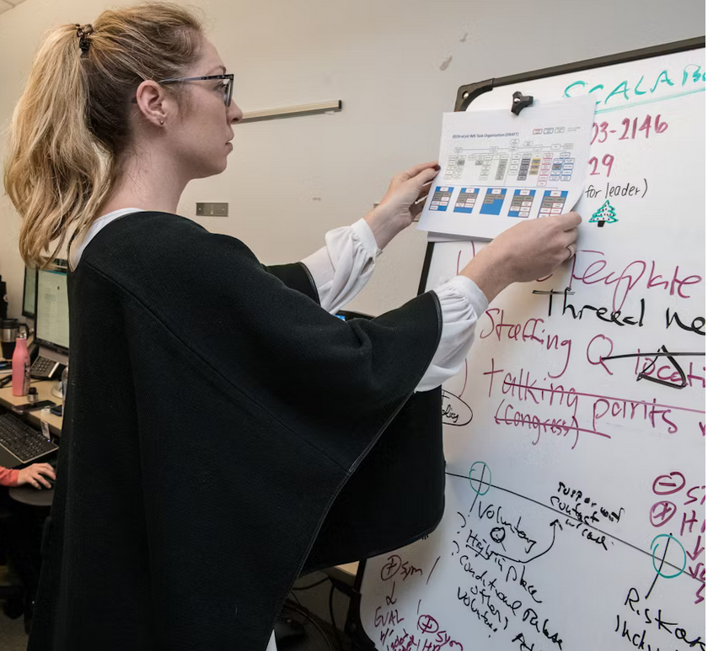
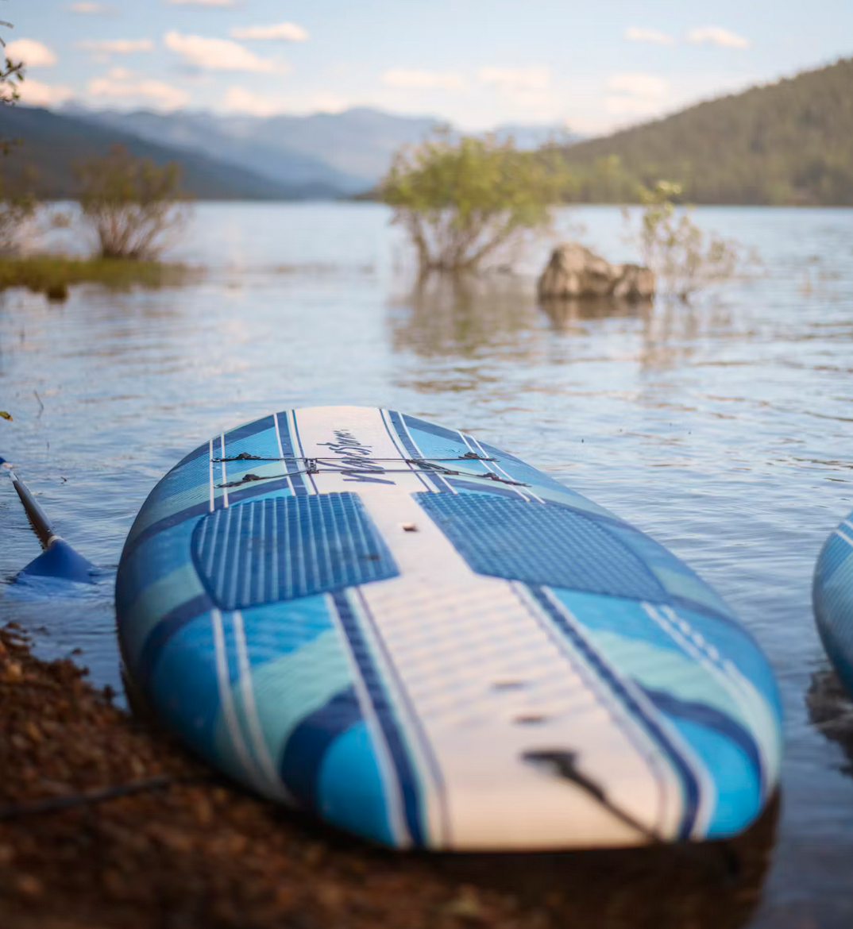
How do you plan your career?
Planning every step Go with the flow
Please share:
Your name
Why did you position yourself just here
What makes career planning important for you just now

Slide 7
Balancing between planning and serendipity
Serendipity
an unplanned fortunate discovery
often cited as being influential in career choices and transitions
Is it just luck or more? Can we ‘help’ to be lucky?

Slide 8

Strategic, longer-term vision

Slide 9
What really matters to me?
Out of all the things you’ve noticed, think about which ones felt like they made the biggest difference to you
if you had to choose the one thing that was the most important to you, what would that be?

Slide 10
Career drivers
Factors that drive your career are highly individual
Evolving / different at different career stage
They reflect your basic needs (salary level), values, motivations, strengths and work preferences
Help us assess where I am and where I want to be
What I need to prioritise

Slide 11
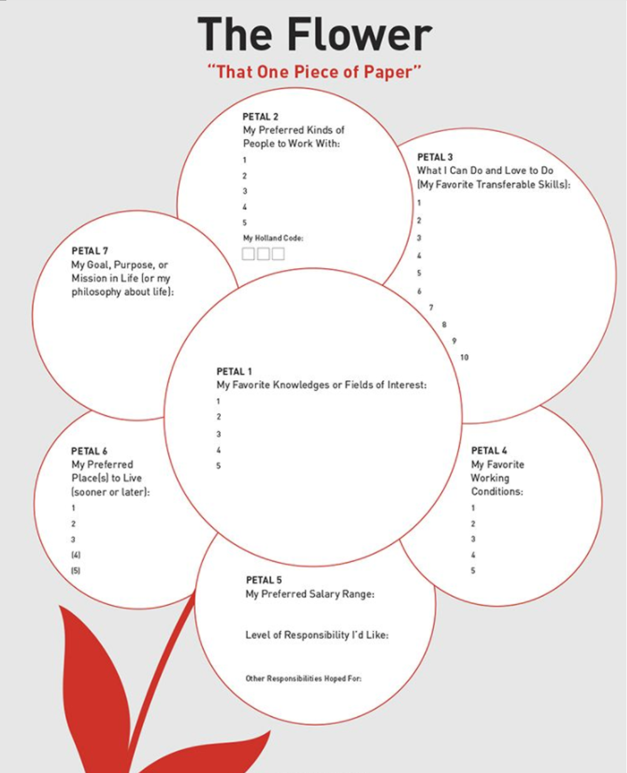
Identifying WHAT I really want and need from my career
Why did you choose to do the things you do
What you enjoy doing most
What motivates you
What helps you to succeed and to feel successful

Slide 12
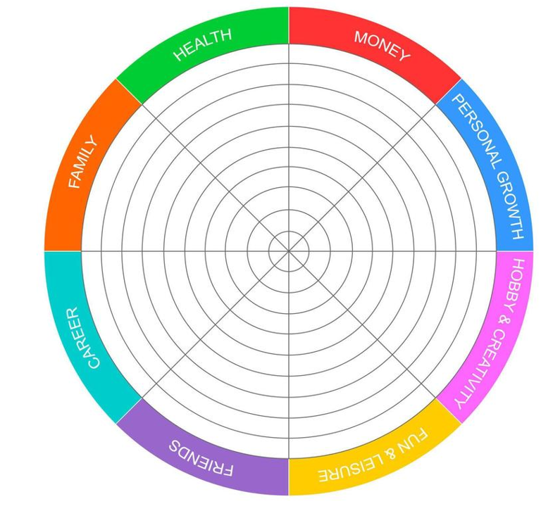
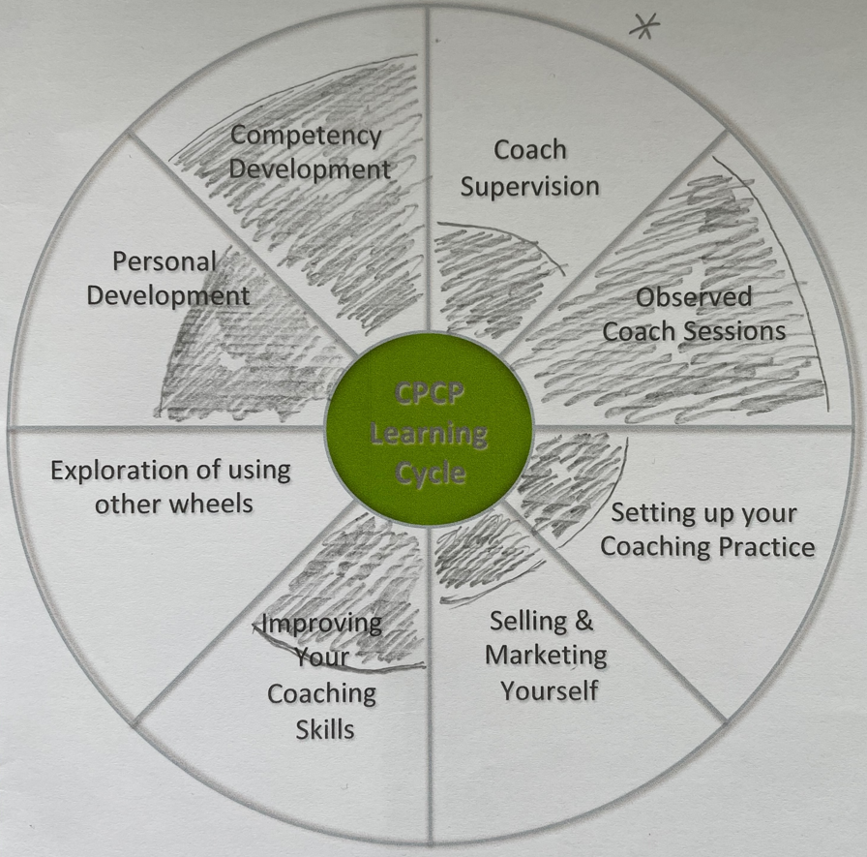
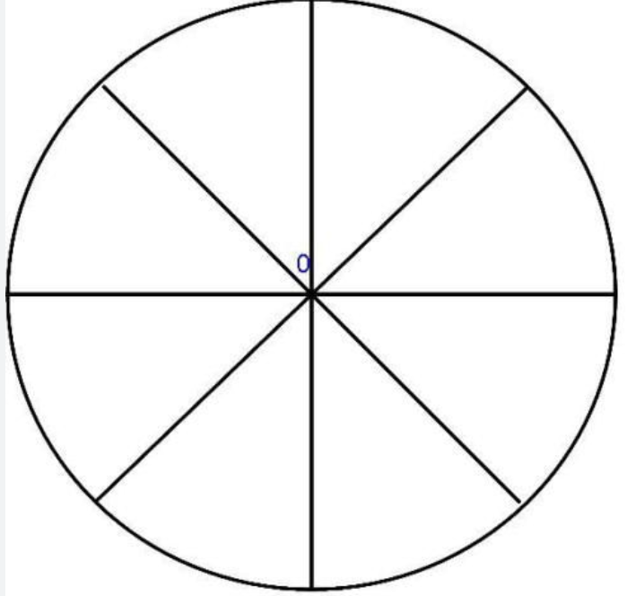
Career development wheel(s)

Slide 13
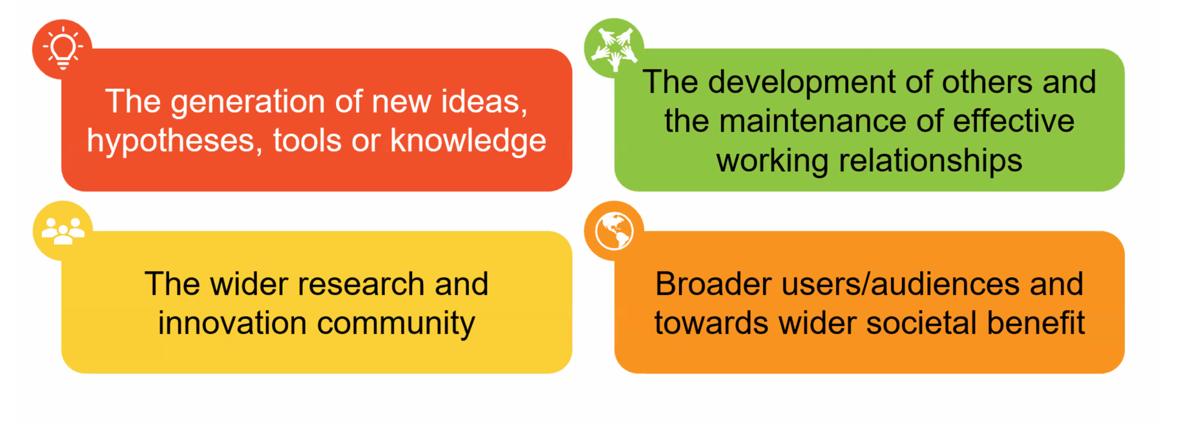
Using Narrative CV template as a framework for career (development) planning
Modified from slides of Taryn Bell, Narrative CV, Prosper webinar

Slide 14
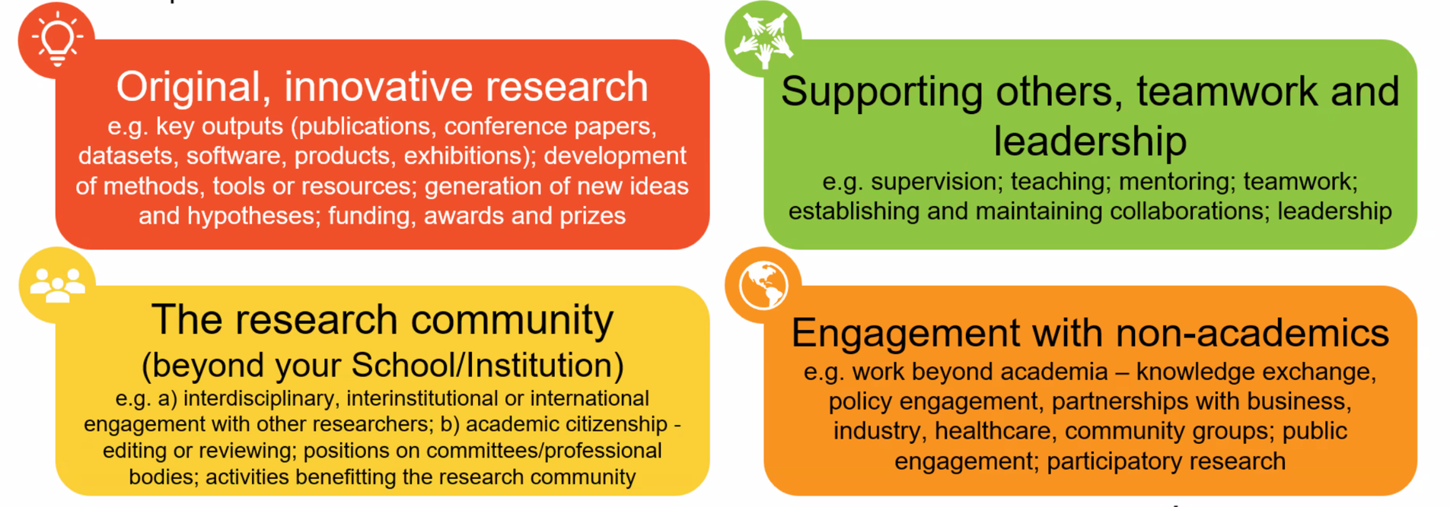

Slide 15




Slide 16
Think – Pair - Share
What are you going to do now about your career planning?
Think of 2-3 immediate actions based on what you learned today and what resonated most with you and your situation
Where will you start
When? How you will ensure you will really do it?
Think individually (1-2 min)
Discuss in pairs (5 min)
Share with everyone (5 min)

Slide 17
In summary
How to find an approach to career planning that works for me
How to identify what I really want and need from my career
How to ensure I am moving in the right direction
Key tips:
Reflect frequently about your career situation (present, change, dream)
Keep refining and adjusting goals and actions
Be alert and prepared for unexpected opportunities
Follow your field, trends, etc.
Use your networks: How can you help each other as a GROW community?

Slide 18
How to ensure I am moving in the right direction – reflection questions
Regularly reflect on your career
What is my long-term career goal now? What are my wants and needs today?
Have they changed? How?
Is what I am doing getting me where I now want to go?
How happy, fulfilled am I in my career right now?
What is going on really well?
What did I do to make it a success?
What do I enjoy most doing?
How can I do more of it?
What is happening in the job market / trends in my field?
What are opportunities for career growth?

Slide 19
Good resources
What Color is your Parachute? by Richard N. Bolles & Katherine Brookes (revised annually)
Prosper
https://prosper.liverpool.ac.uk/postdoc-resources/career-development-navigator/
Narrative CVs resource
https://universityofleeds.padlet.org/tlbell2/narrative-cv-resources-4ycihvl4qbvv2n90

Slide 20
What is one thing that most resonated with you that will help you with your career planning
Dr Iveta Simera
Coaching for Research Leaders
Email: isimera@gmail.com
All downloaded photos copyright-free from pexels.com or unsplash.com

